Slide 1


Distributed Attribute-Based Access Control System Using a Permissioned Blockchain
Phạm Nguyễn Hải Anh
Nguyễn Lê Thảo Ngọc

Slide 2
INTRODUCTION
1

Slide 3
Access control systems
Labeled resource
attributes
DAC
MAC
RBAC
ABAC
rule for SID
role for user
2

Slide 4
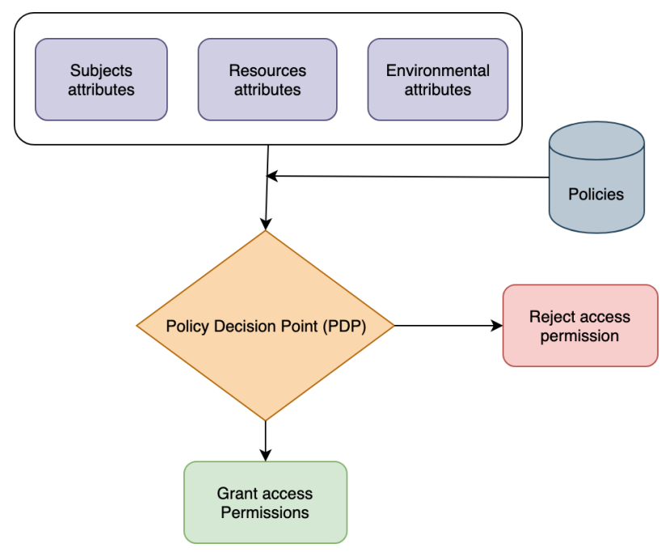
An access control model
Authorization: <o, s, p> - subject s has privilege p for object o
Attribute-based Access Control
Corrupted admin?
3

Slide 5
BACKGROUND & RELATED WORK
4

Slide 6
Fabric network
Lib A
Lib B
Lib C
6

Slide 7
Fabric network
Lib A
Lib B
Lib C
Channel 1
Channel 2
7

Slide 8
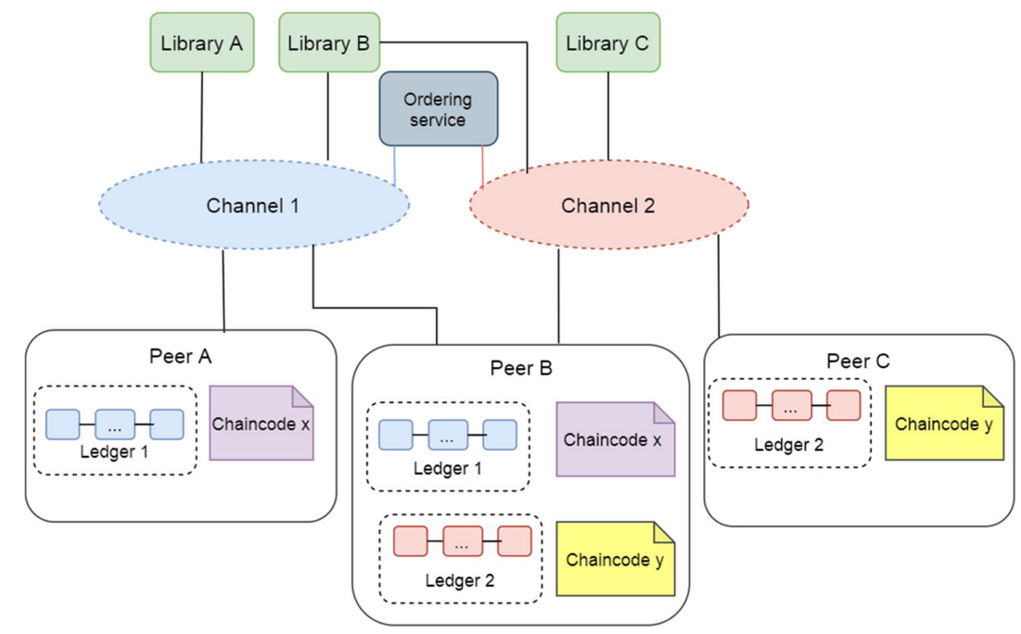

Fabric network
CA B
CA A
CA C
8

Slide 9
Fabric network
CA B
CA A
CA C
8

Slide 10
Fabric network
CA B
CA A
CA C
9

Slide 11
Fabric system
Block
Block
Block
Block
Gateway
Smart contract API
Lib A
State database (goleveldb, couchdb)
Ledger 1
Fabric network
9

Slide 12
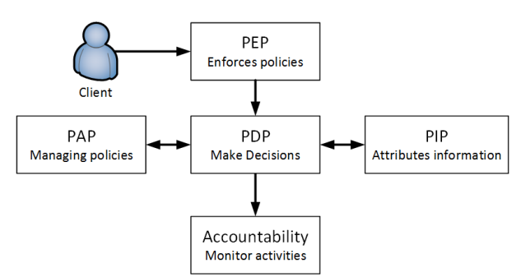
ABAC logical components
10

Slide 13
SYSTEM ARCHITECTURE
9

Slide 14
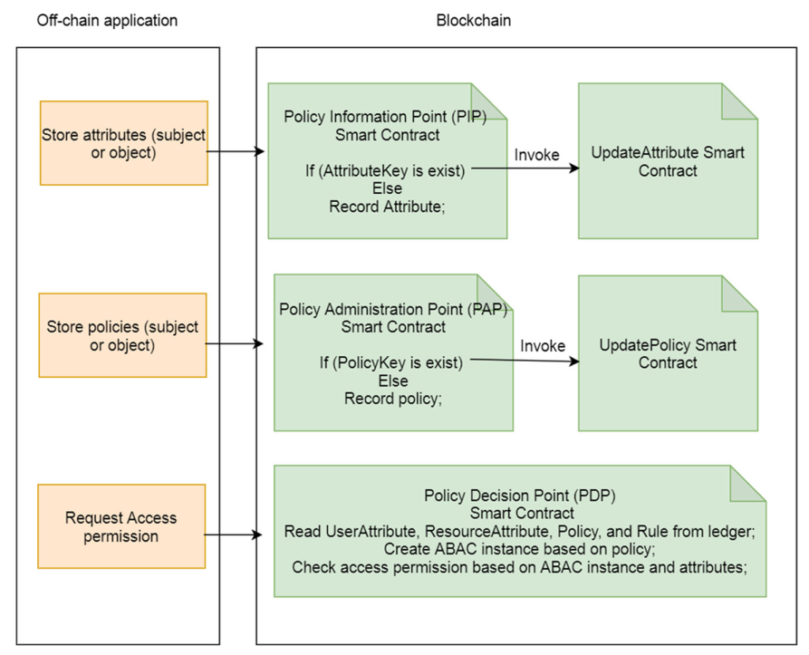
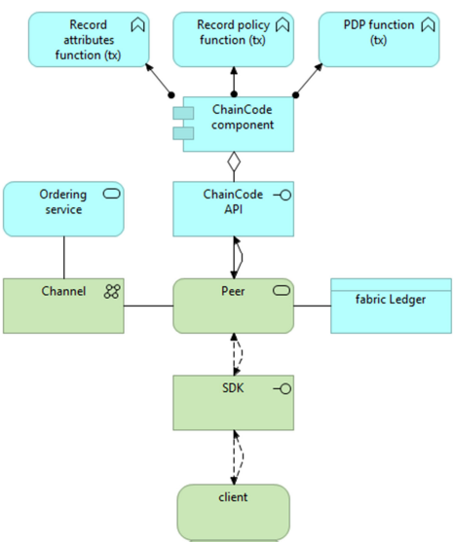
System architecture
11

Slide 15
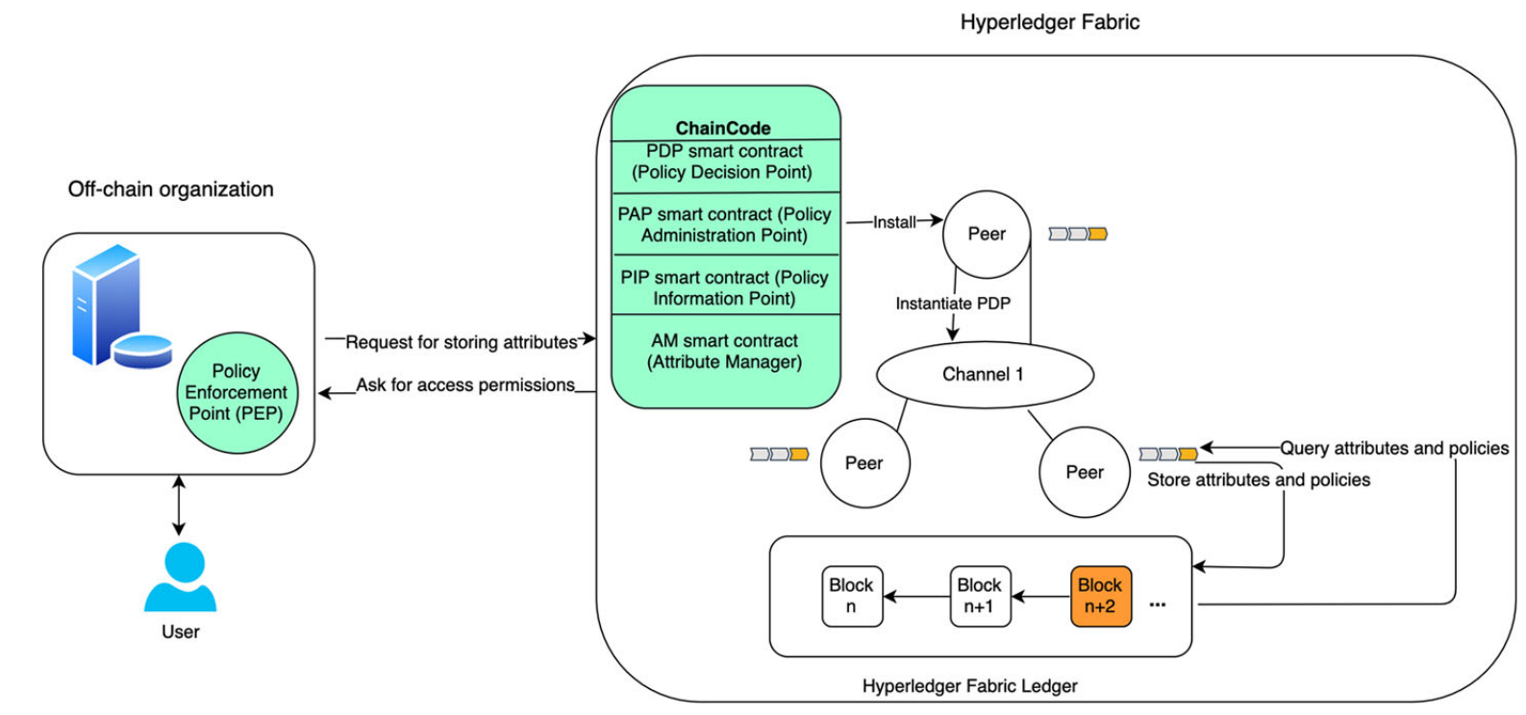
System architecture
10

Slide 16
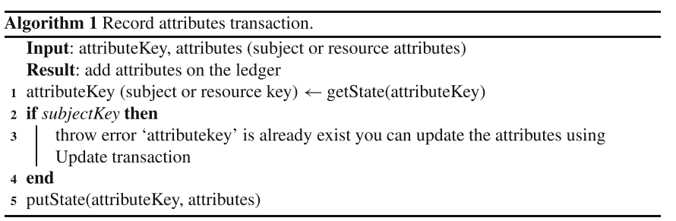
Algorithms
Algorithm 1 shows how the list of resources and subjects attributes are stored in the ledger.
12

Slide 17
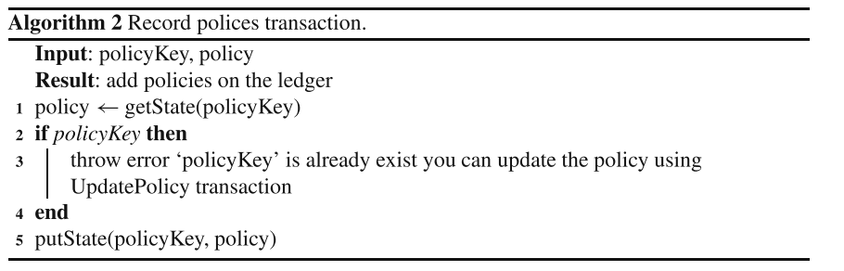
Algorithms
Algorithm 2 presents how policies are recorded in the ledger.
13

Slide 18
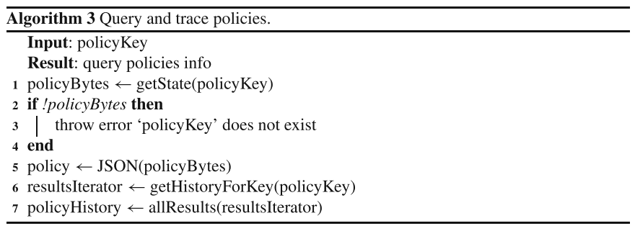
Algorithms
Algorithm 3 explains how to query policies and the history of changes to the policies from​the ledger.
14

Slide 19
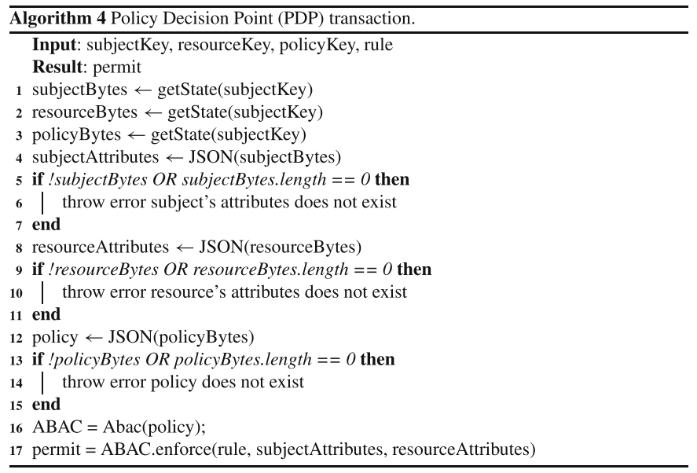
Algorithms
Alg 4 shows the detailed implementation of the PDP transaction,which includes querying the relevant attributes and policies from the ledger and making a decision based on their values.
15

Slide 20
CASE STUDY
16

Slide 21
Digital library
policy = {
‘‘policy ID’’: ‘‘policy01’’,
attributes : {
‘‘user’’:{
‘‘status’’: ‘‘Active’’,
‘‘ expiration’’:‘‘Date of expiration’’,
‘‘ libraryGroup’’:‘‘Group ID’’
},
‘’resource’’:{
‘‘libraryGroup’’:‘‘Group ID’’}
},
‘‘rules’’:{
‘‘user.status’’:{
‘‘comparison type’’: ‘‘boolean ’’,
‘‘ comparison’’: ‘‘boolAnd’’,
‘‘ value’’:true},
‘‘user.expiration’’: {
‘‘comparison type’’: ‘‘datetime’’,
‘‘comparison’’: ‘‘isMoreRecentThan ’’,
‘‘value’’: ‘‘1DAY’’
},
‘‘user.libraryGroup’’: {
‘‘comparisontarget’’: ‘‘libraryGroup’’,
‘‘comparison type’’: ‘‘numeric’’,
‘‘comparison’’: ‘‘is stricly equal ’’,
‘‘field’’: ‘‘resource.libraryGroup’’
}
}
}
}
S₁A = {“s001”, {“status”, true}, {“expiration”, “2020− 05 − 12”}, {“libraryGroup”, 12}}
O₁A = {“r001”, {“libraryGroup”, 12}}
Policy P1 with id “policy01”: P1 = {“policy01”, S₁A, O₁A, {“status == true” ∧ “expiration” > “1Day” ∧ “user.libraryGroup” == “resource.libraryGroup”}}
18

Slide 22
SYTEM EVALUATION
19

Slide 23
Configuration
+ A vm on Google Cloud: 8 CPUs, ram 8GB, n2-highcpu-8
+ Kafka, Raft supported in Fabric (Caliper benchmark)
+ Subject, Object attribute and policies format: json
+ clients in blockchain network: 10
+ Txs: 5000
+ Default orgs: 2
+ Default peer: 1
20

Slide 24
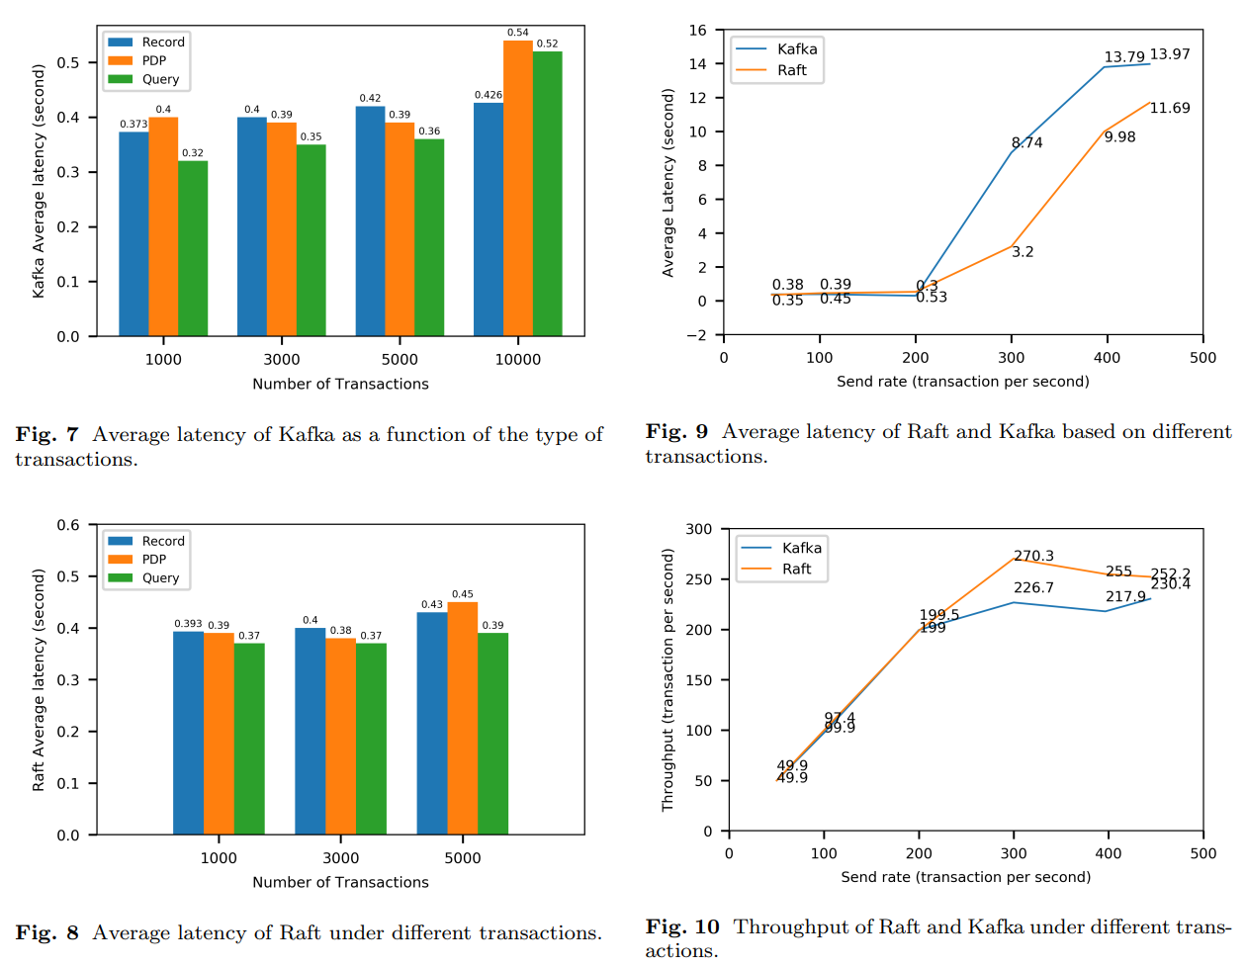
21

Slide 25
SOURCE CODE
19

Slide 26
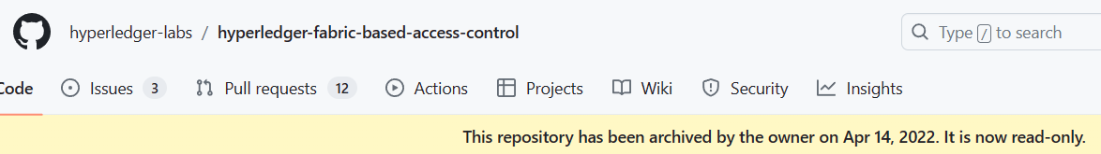
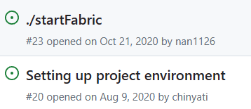
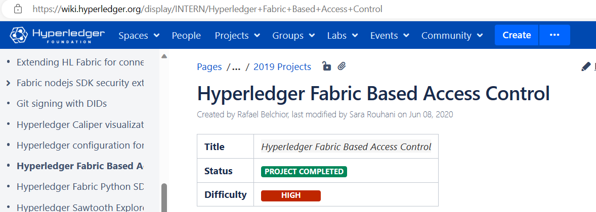
Paper’s related projects
Git:
Project in Hyperledger:
23

Slide 27
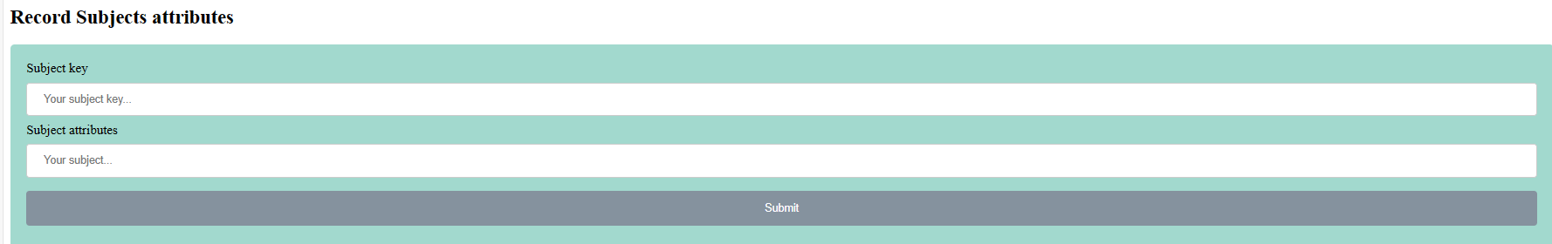
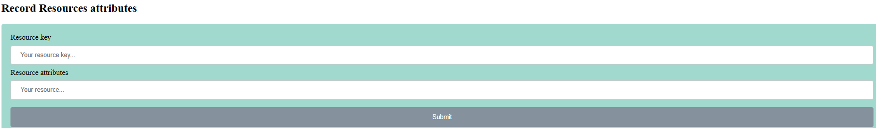
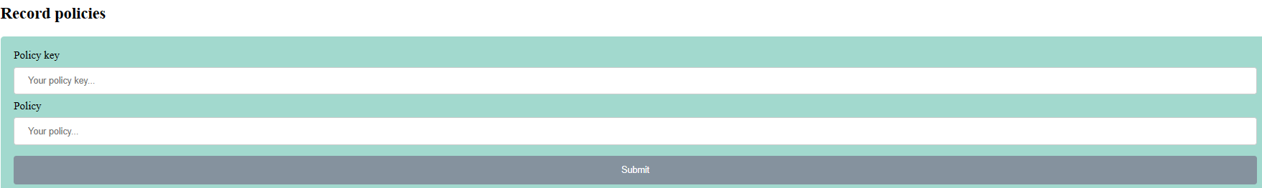
Paper’s source code
Web-UI:
23

Slide 28
OUR WORK
19

Slide 29


Rebuild
Custom abac fabric-sample
-------------------------------------------------------------------------------------
PEP |
-------------------------------------------------------------------------------------
PDP |
-------------------------------------------------------------------------------------
PIP |
-------------------------------------------------------------------------------------
PAP |
-------------------------------------------------------------------------------------
19

Slide 30
DEMO
19

Slide 31
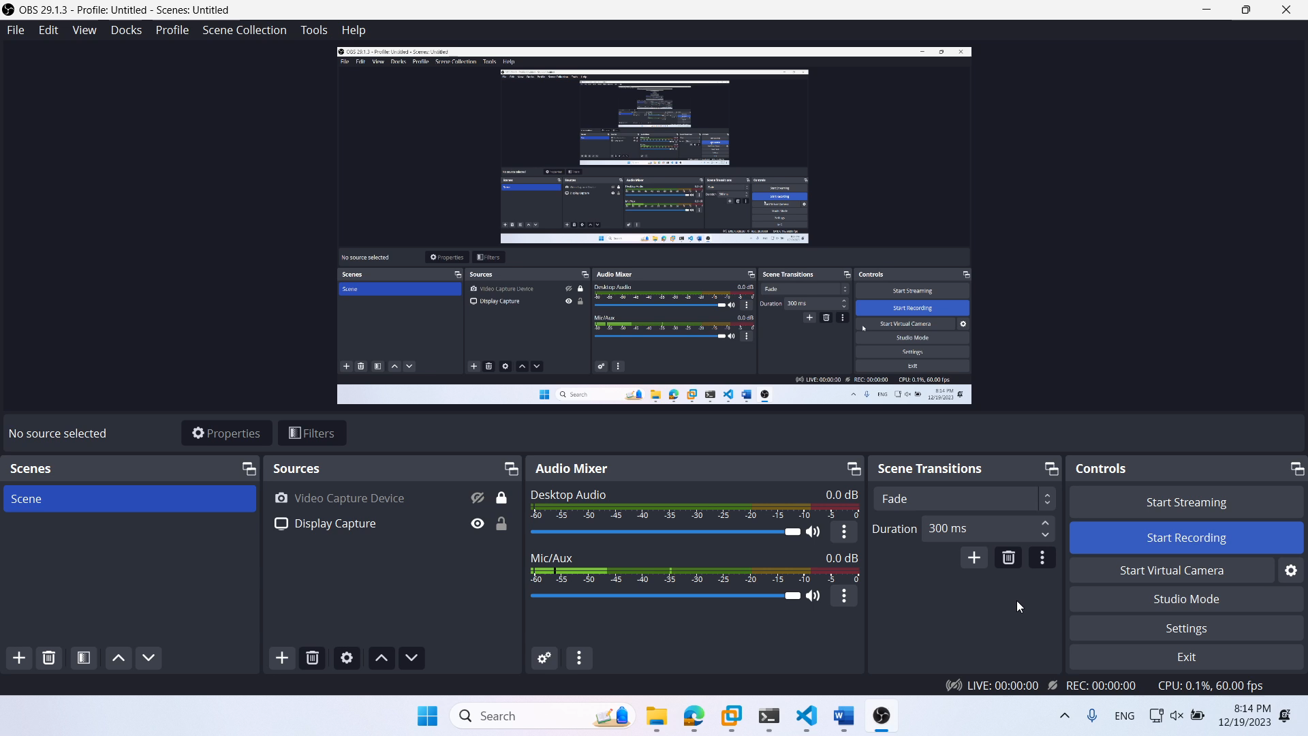

Slide 32
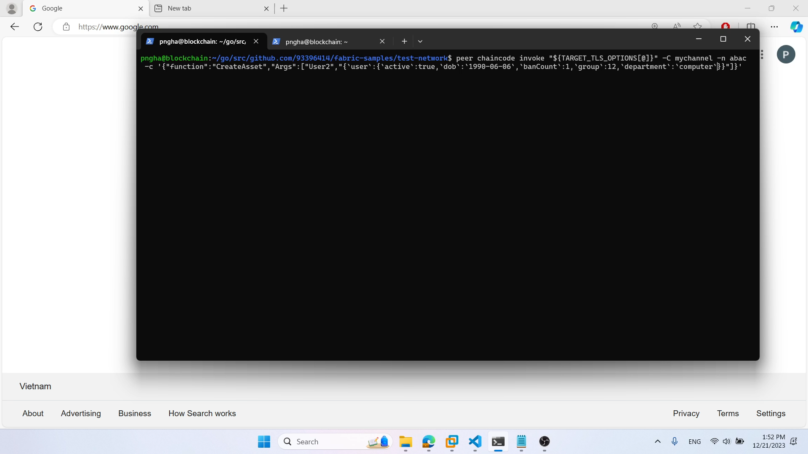

Slide 33
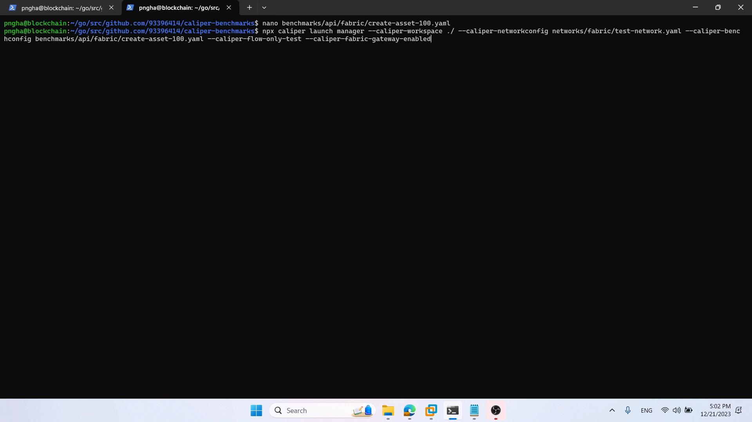

Slide 34
Benchmark sample
Name | Succ | Fail | Send Rate (TPS)
100 | 12017 | 7 | 100.1
150 | 18008 | 16 | 150
200 | 11572 | 11722 | 193.2
250 | 10973 | 13621 | 204.6
300 | 12343 | 12004 | 202.4
Name | Max Latency (s) | Min Latency (s) | Avg Latency (s) | Throughput (TPS)
100 | 2.12 | 0.04 | 0.15 | 98.4
150 | 5.22 | 0.05 | 2.59 | 147.5
200 | 65.5 | 0.17 | 41.7 | 156.2
250 | 61.92 | 0.34 | 40.65 | 167
300 | 65.35 | 0.39 | 41.77 | 166.9

Slide 35
THANK YOU

Slide 36
Paper info
1. Paper Name: Distributed attribute-based access control system using permissioned blockchain
2. Authors: Sara Rouhani - Rafael Belchior - Rui S. Cruz - Ralph Deters
3. Published Year: 2021
4. Journal: World Wide Web - Springer
2

Slide 37
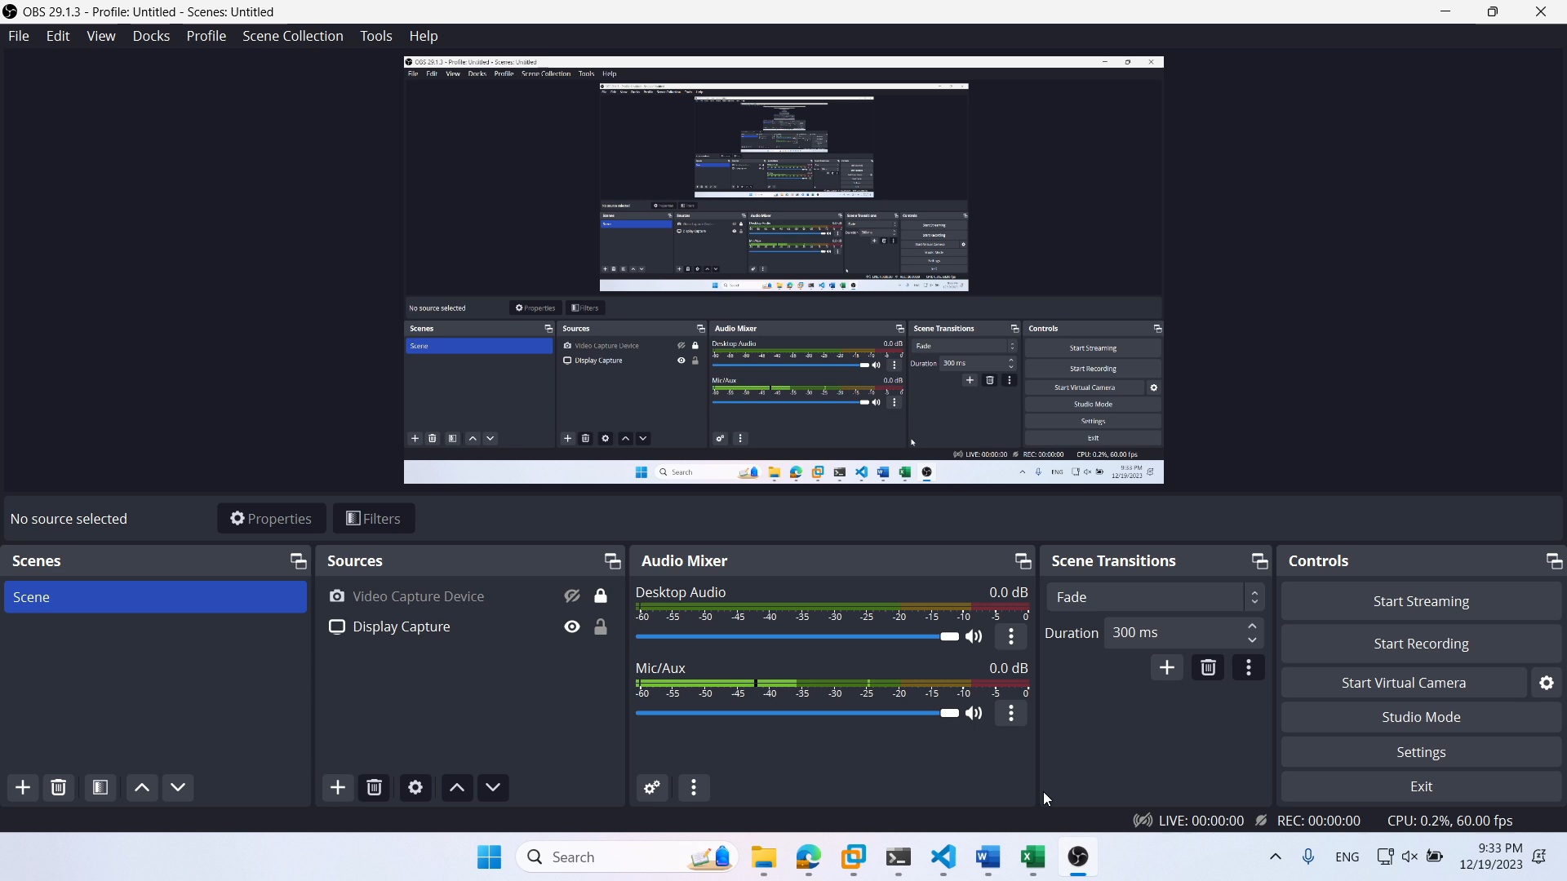

Slide 38
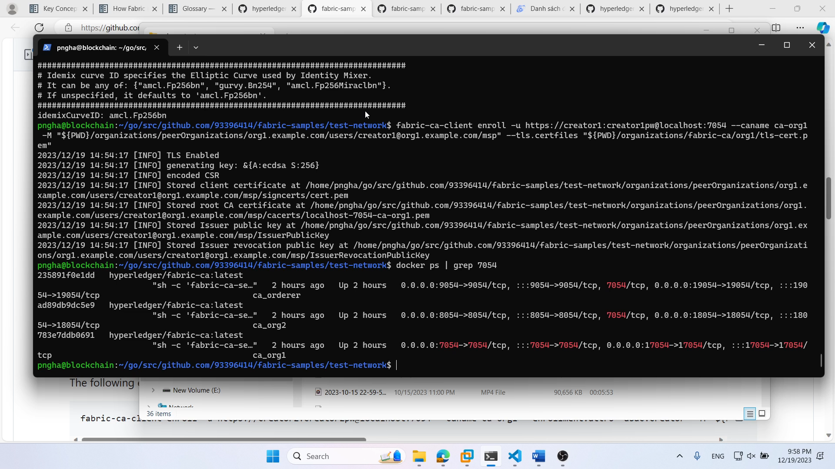

Slide 39
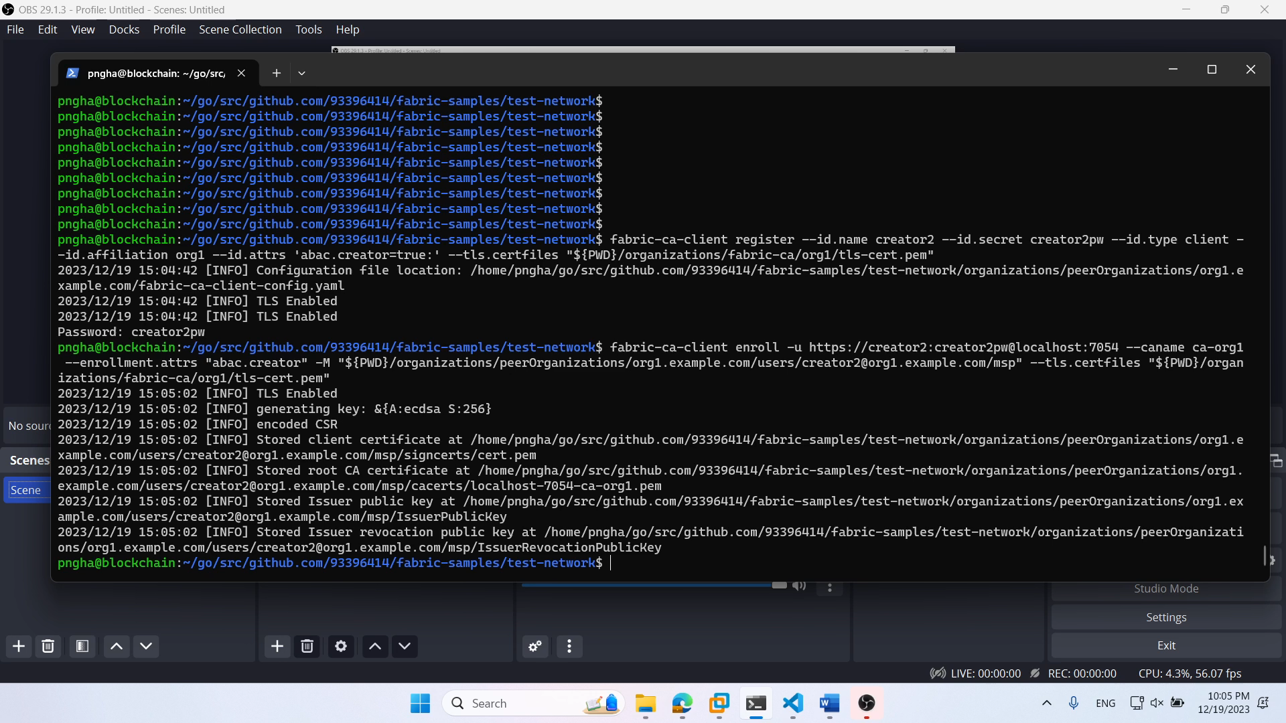

Slide 40


